Slide 1

Managing a Diverse Workforce
Chapter 16
©2020 McGraw-Hill Education. All rights reserved. Authorized only for instructor use in the classroom. No reproduction or further distribution permitted without the prior written consent of McGraw-Hill Education.

Slide 2

The Changing Face of the Workforce1
Diversity: variation is the human characteristics that distinguish people from one another.
Workforce diversity: diversity among employees
Notes:
Diversity: variation in the important human characteristics that distinguish people from one another.
Primary dimensions: age, ethnicity, gender, mental or physical abilities, race, sexual orientation.
Secondary dimensions: characteristics such as communication style, family status and first language.
Workforce diversity: diversity among employees of a business or organization:
Represents both a challenge and an opportunity for businesses.
Today, the U.S. workforce is as diverse as it ever has been. Consider the following workforce diversity trends:
Immigration has profoundly reshaped the workplace:
In 2017, 27 million immigrants were working in the United States, comprising almost 17 percent of the workforce.
Ethnic and racial diversity is increasing:
By 2022, the U.S. workforce is projected to be about 39 percent nonwhite.
The workforce will continue to get older:
By 2024 the U.S. Bureau of Labor Statistics projects that 36 percent of 65- to 69-year-olds will continue to work.
Millennials are entering the workforce:
In 2015, millennials became the largest generation in the U.S. workforce.

Slide 3
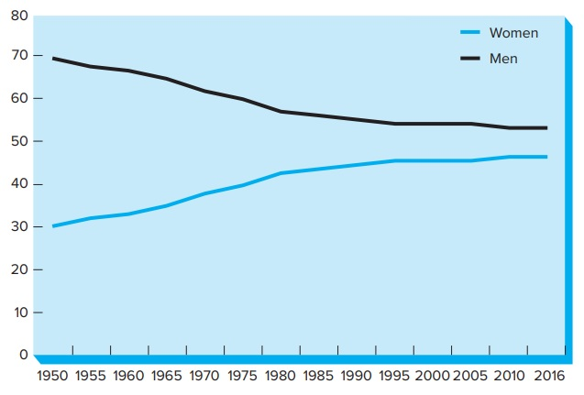
Proportion of Women and Men in the Labor Force, 1950-2016
Figure 16.1
Copyright © McGraw-Hill Education. Permission required for reproduction or display.
Access the text alternative for these images.
Notes:
Between 1950 and the late 2000s, the proportion of women working outside the home rose dramatically.
Has remained between 46 and 47 percent since then.
Men’s participation rates declined between 1950 and 2016.
The proportion of adult men who worked fell from 70 percent to about 53 percent.

Slide 4

Gender and Race in the Workplace2
Labor force rates for men and women are converging
Pay gap: Women and persons of color on average receive lower pay than white men do.
Notes:
Labor force rates for men and women are converging due to:
Illness, disability, and incarceration have negatively impacted men more than women.
The increase in women’s participation has been attributed to higher levels of educational attainment, delayed child bearing and a decreasing tendency of women staying home to raise children.
Pay gap: Women and persons of color on average receive lower pay than white men do.
Gap has narrowed over the past quarter century.
The one group that tops white men in median weekly earnings is Asian-American men; they make about $1.17 for every dollar that a white man earns.
Important reason is education.

Slide 5
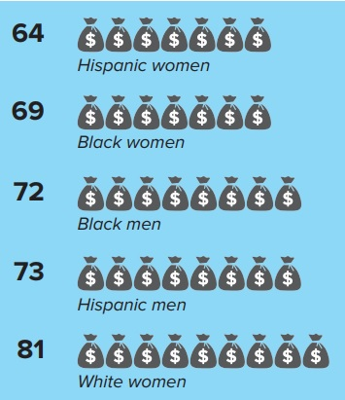
The Gender and Race Pay Gap, 2017
(cents on the dollar)
Figure 16.2
Copyright © McGraw-Hill Education. Permission required for reproduction or display.
Access the text alternative for these images.

Slide 6


The Gender and Racial Pay Gap2
Possible reasons for gender pay gap:
  Sex discrimination.
  Women’s choices to pursue lower paying jobs or slower advancement.
  Occupational segregation: Inequitable concentration of a group in certain job categories.
Pink-collar ghetto
Notes:
Possible reasons for gender pay gap:
Sex discrimination.
Women’s choices to pursue lower paying jobs or slower advancement.
Occupational segregation: Inequitable concentration of a group in certain job categories.
Pink-collar ghetto: means that many women are stuck in certain jobs, mostly low-paying jobs and usually because of their sex
sex-typed jobs:
Women have made great strides in entering professional occupations, however “pink collar ghetto” still exists.
Examples: preschool teacher, hairdressers, dental hygienists.
One area of the economy where racial and gender discrimination seems stubbornly persistent is high technology.
Examples:
Yahoo! is 61 percent white, 63 percent male.
Facebook is 49 percent white, 65 percent male.

Slide 7

Where Women and Persons of Color Manage1
Women and Management Role
Visible Minorities Representations
Notes:
In 2018 around half of all managers and professionals were women.
Slightly more than 9 million women were working as managers by the mid-2010s.
Women managers tend to be concentrated in occupations where women are numerous at lower levels:
→ Examples: education and health care.
Where do persons of color manage?
Blacks have made progress in educational administration and human resources.
Hispanics have progressed in property and real estate.
Asians are somewhat overrepresented in management ranks, particularly in the field of information systems.

Slide 8
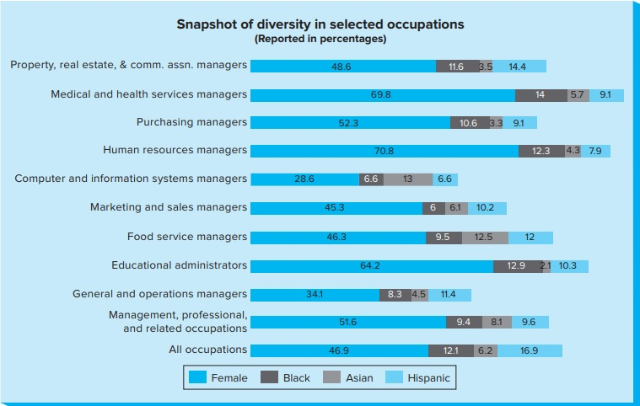
Snapshot of Diversity in
Selected Occupations
Copyright © McGraw-Hill Education. Permission required for reproduction or display.
Figure 16.3
Access the text alternative for these images.

Slide 9

Breaking the Glass Ceiling1
Glass ceiling: Invisible barrier that exists in reaching these higher levels is sometimes called the glass ceiling.
Benefits of Diversity towards improved performance
Reasons for Glass Ceiling
Notes:
Although women and minorities are as competent as white men in management, they rarely attain the highest positions in corporations.
Glass ceiling: Invisible barrier that exists in reaching these higher levels is sometimes called the glass ceiling.
Recent advances show some cracking of the ceiling.
Another key measure of diversity is the representation of women on corporate boards.
Worldwide, women held 15 percent of directorships in 2016, with variations per nation.
In 2015, Germany required companies to give 30 percent of board seats to women, joining other European nations with similar rules.
In the United States and United Kingdom, investors are pressuring companies to appoint more women and minorities.
Recent studies have shown:
Companies with a higher proportion of women on their boards were less likely to be involved in corruption and earned higher scores for management of carbon emissions, toxic releases.
Another recent review of academic studies concluded that greater gender diversity on boards did not make much difference.
Would adding women to boards improve performance?
More diverse boards avoid a rush to consensus and realistically consider alternative courses of action.
Women bring different life experiences to the table and are more likely to raise multiple stakeholder concerns.
The Aspen Institute has argued that women simply lead differently, demonstrating traits such as empathy, collaboration, and skill at conflict resolution.
Reasons for Glass Ceiling
What continues to hold women and minorities back as executives and directors?
Many women and minorities start in staff rather than line positions.
Recruiters fill positions by word of mouth, using “old boys network.”
Companies lack commitment to diversity.
Too little accountability for equal employment opportunity at top management levels.

Slide 10
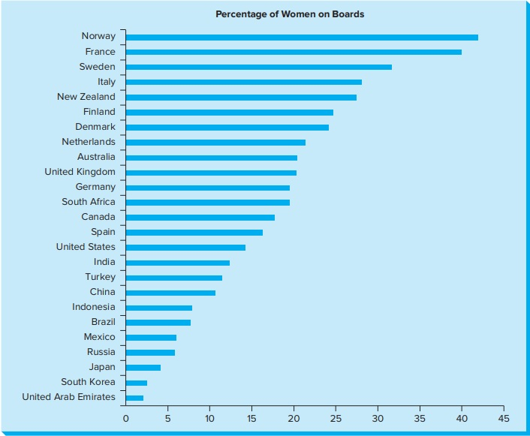
Women as a Percentage of Members of Boards of Directors, Selected Countries, 2016
Figure 16.4
Copyright © McGraw-Hill Education. Permission required for reproduction or display.
Access the text alternative for these images.

Slide 11

Women and Minority Business Ownership
Some women and minorities have chosen to avoid the glass ceiling by opening their own businesses.
In 2015, there were almost one million minority-owned business in the United States.
Notes:
Some women and minorities have chosen to avoid the glass ceiling by opening their own businesses.
By the mid-2010s, 36 percent of over 28 million U.S. businesses were owned by women, and 15 percent by minorities.
Example: Turkish immigrant Hamdi Ulukaya and Chobani Yogurt.
In 2015, there were almost one million minority-owned business in the United States.
More than 50 percent of these firms were owned by Asians, Hispanics about 32 percent, and African Americans about 11 percent.

Slide 12


Equal Employment Opportunity1
Discrimination based on race, color, religion, sex, national origin, physical or mental disability, or age is prohibited in all employment practices.
Notes:
Discrimination based on race, color, religion, sex, national origin, physical or mental disability, or age is prohibited in all employment practices.
Government contractors must have written affirmative action plans detailing how they are working positively to overcome past and present effects of discrimination in their workforce.
Women and men must receive equal pay for performing equal work, and employers may not discriminate on the basis of pregnancy.

Slide 13

Affirmative Action1
Purpose: to reduce job discrimination by encouraging companies to take positive steps to overcome past discriminatory employment practices.
Affirmative action has long been controversial.
Notes:
Backers of affirmative action argue that these programs provide an important tool for achieving equal opportunity.
Women and minorities continued to face discriminatory barriers, and affirmative action levels the playing field.
Critics of affirmative action say it is inconsistent with the principles of fairness and equality.
In some cases, one group could be unintentionally discriminated against in an effort to help another group.
These programs can actually stigmatize or demoralize the very groups they are designed to help.

Slide 14
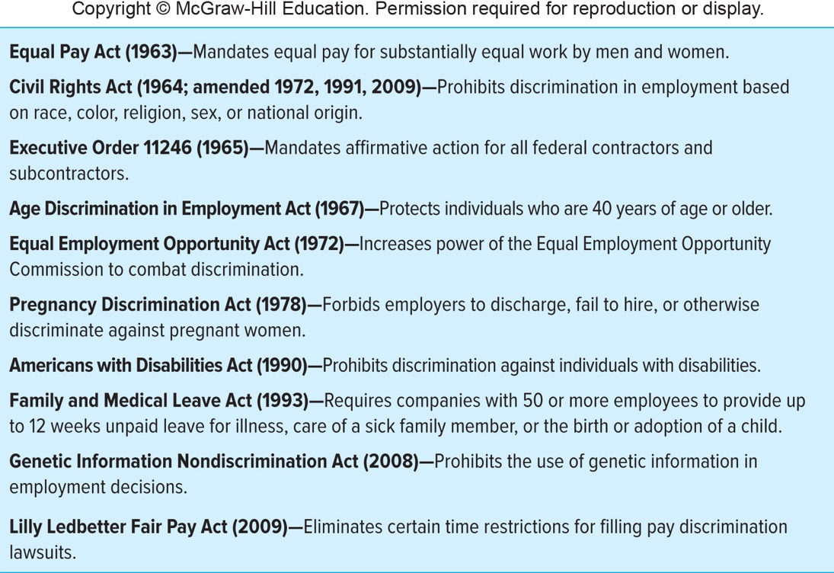
Major Federal Laws and Executive Orders Prohibiting Job Discrimination
Figure 16.5
Copyright © McGraw-Hill Education. Permission required for reproduction or display.
Access the text alternative for these images.

Slide 15


Harassment
Sexual Harassment
Racial Harassment
Preventing Sexual and Racial Harassment
Notes:
Sexual Racial Harassment
Sexual Harassment
Government regulations ban sexual and racial harassment.
Sexual harassment at work occurs when:
An employee, woman or man, experiences repeated, unwanted sexual attention.
On‑the‑job conditions are hostile or threatening in a sexual way.
It includes both physical conduct.
Examples: Suggestive touching, verbal harassment
It can also occur if a company’s work climate is blatantly and offensively sexual or intimidating to employees.
U.S. EEOC is empowered to sue on behalf of victims.
Sexual harassment cases are settled in arbitration hearings so the amounts paid are not made public.
Racial Harassment
Illegal, under Title VII of the Civil Rights Act:
Under EEOC guidelines, ethnic slurs, derogatory comments, or other verbal or physical harassment based on race are against the law.
if they create an intimidating, hostile, or offensive working environment or interfere with an individual's work performance.
Preventing Sexual and Racial Harassment
The Supreme Court ruled that companies could deflect lawsuits by taking two steps:
Developing a zero-tolerance policy on harassment and communicate it clearly to employees.
Establishing a complaint procedure—including ways to report incidents without retaliation—and acting quickly to resolve any problems.
Companies that took such steps would be protected from suits by employees who claimed harassment but had failed to use the complaint procedure.

Slide 16

What Business Can Do:
Diversity and Inclusion Policies and Practices1
Diversity and Inclusion Policies and Practices2
Strategic Advantages of Managing
Balancing Work and Life
Notes:
Diversity and Inclusion Policies and Practices
Actions companies can take to manage diversity and promote inclusion effectively:
Articulate a clear diversity mission, set quantitative objectives, and hold managers accountable.
Spread a wide net in recruitment, to find the most diverse possible pool of qualified candidates.
Incorporate selection techniques that diminish the opportunity for bias.
Actions companies can take to manage diversity and promote inclusion effectively:
Identify promising women and persons of color, and provide them with mentors and other kinds of support.
Set up diversity councils to monitor the company’s goals and progress toward them:
Diversity council: A group of managers and employees responsible for developing and implementing specific action plans to meet an organization’s diversity goals.
Strategic Advantages of Managing
Having a widely diverse workforce boosts innovation, many executives believe.
The global marketplace demands a workforce with language skills, cultural sensitivity, and awareness of national and other differences across markets.
Companies with effective diversity programs can avoid:
Costly lawsuits.
Damage to their corporate reputations from charges of discrimination or cultural insensitivity
Balancing Work and Life
How can companies best help employees balance the complex, multiple demands of work and family life?

Slide 17

Child Care and Elder Care1
Types of programs companies are offering:
A major source of workplace stress for working parents is concern about their children.
Many of today’s families have responsibilities for elder care
Notes:
Types of programs companies are offering:
Child care.
Elder care.
Parental and family leave.
A major source of workplace stress for working parents is concern about their children.
Studies have found that child care programs help:
To reduce absenteeism and tardiness.
To improve productivity.
To aid recruiting, by improving the company’s image.
To retain talented employees.
.
Many of today’s families have responsibilities for elder care:
43.5 million adults in the United States now care for an older person.
More than half (56 percent) of family caregivers are currently employed.
Many firms offer referral services, dependent care accounts, long-term care insurance, and time off to deal with the often unpredictable crises that occur in families caring for children and elders.

Slide 18

Work Flexibility1
Companies have also accommodated the changing roles of women and men by offering workers more flexibility
These arrangements can benefit employers by attracting and retaining valuable employees, reducing absences, and improving job satisfaction.
Notes:
Companies have also accommodated the changing roles of women and men by offering workers more flexibility through such options as:
Flextime.
Part-time employment.
Job sharing.
Working from home.
These arrangements can benefit employers by attracting and retaining valuable employees, reducing absences, and improving job satisfaction.
However, many women and men have been reluctant to take advantage of various flexible work options:
Fearing that this would put them on a slower track, sometimes disparagingly called the Mommy track or Daddy track

Slide 19

LGBT Rights at Work
An important step businesses can take is to support their lesbian, gay, bisexual and transgender employees.
Notes:
An important step businesses can take is to support their lesbian, gay, bisexual and transgender employees.
83 percent of Fortune 500 companies include sexual orientation in their nondiscrimination policy.
97 percent include gender identity.

Slide 20

The Family-Friendly Workplace
Family-friendly workplace : firms that fully support both men and women in their efforts to balance work and family responsibilities.
Notes:
Family-friendly workplace : firms that fully support both men and women in their efforts to balance work and family responsibilities.
Job advantages would not be granted or denied on the basis of gender.
People would be hired, paid, evaluated, promoted, and extended benefits on the basis of their qualifications and ability to do the tasks assigned.
The route to the top, or to satisfaction in any occupational category, would be open to anyone with the talent to take it.
The company’s stakeholders, regardless of their gender, would be treated in a bias-free manner.
All laws forbidding sex discrimination would be fully obeyed.

Slide 21
End of Main Content

Slide 22
Accessibility Content:
Text Alternatives for Images

Slide 23
Proportion of Women and Men in the Labor Force, 1950-2016
Text Alternative
The x-axis contains fourteen markings. From the left to the right, these markings read 1950, 1955, 1960, 1965, 1970, 1975, 1980, 1985, 1990, 1995, 2000, 2005, 2010, and 2016.
The y-axis contains nine markings. From the bottom to the top, these markings read 0, 10, 20, 30, 40, 50, 60, 70, and 80.
A key indicates that the blue, or lower, line represents women’s participation rates while the black, or upper line, displays the participation rates of men over the years.
In 1950, the proportion of men working was at 70 percent while women were only at 30 percent. Between 1950 and 1980 the proportion of men declined steadily while that of women rose at nearly the same rate so that by 1980 women’s participation rose to 40 percent while men dropped to 60 percent.
From 1980 to 1995 the trend continued at a slower rate so that in 1995 the proportion of men working was around 55 percent with women at about 45 percent.
Between 1995 and 2005 there was a one to two percent uptick in men working, coupled with a similar decline in the number of women working.
Between 2005 and 2016, men’s and women’s participation rates converged to the closest in history with the proportion of men around 53 percent and women near 47 percent.
Return to slide containing original image.

Slide 24
The Gender and Race Pay Gap, 2017 (cents on the dollar)
Text Alternative
The figure uses images of money bags to depict the average weekly earnings of each group expressed by the number of cents on the dollar each minority earns compared to white men.
From top to bottom, the data reads as follows:
Hispanic women earn 64 cents on the dollar.
Black women earn 69 cents on the dollar.
Black men earn 72 cents on the dollar.
Hispanic men earn 73 cents on the dollar.
White women earn 81 cents on the dollar.
Return to slide containing original image.

Slide 25
Snapshot of Diversity in Selected Occupations Text Alternative
Ten occupations plus an aggregated total are listed along the y-axis. From the bottom to the top, the labels read as follows:
All occupations; management, professional, and related occupations; general and operations managers; educational administrators; food service managers; marketing and sales managers; computer and information systems managers; human resources managers; purchasing managers; medical and health service managers; and property, real estate, and community association managers.
One bar extends from left to right for each of the occupations, parallel to the x-axis.
A key at the bottom of the graph uses color-coding to represent the different groups of workers including female, Black, Asian, and Hispanic.
From top to bottom, the data reads as follows:
Property, real estate, & community association managers include 48.6 percent female; 11.6 percent Black; 3.5 percent Asian; 14.4 percent Hispanic, the largest category for Hispanics.
Medical and health services managers have 69.8 percent female; 14 percent Black; 5.7 percent Asian; and 9.1 percent Hispanic.
Purchasing managers consist of 52.3 percent female; 10.6 percent Black; 3.3 percent Asian; and 9.1 percent Hispanic.
Human resources managers are made up of 70.8 percent female, the largest type of work for females; 12.3 percent Black; 4.3 percent Asian; and 7.9 percent Hispanic.
Computer and information systems managers break down into 28.6 percent female; 6.6 percent Black; 13 percent Asian, the largest of the Asian occupations; and 6.6 percent Hispanic.
Marketing and sales managers consist of 45.3 percent female; 6 percent Blacks; 6.1 percent Asian; and 10.2 percent Hispanic.
Food service managers are made up of 46.3 percent female; 9.5 percent Black; 12.5 percent Asian; and 12 percent Hispanic.
Educational administrators have 64.2 percent female; 12.9 percent Black, the largest profession for Blacks; 2.1 percent Asian; and 10.3 percent Hispanic;
General and operations managers are 34.1 percent female; 8.3 percent Black; 4.5 percent Asian; and 11.4 percent Hispanic.
Management, professional, and related occupations include 51.6 percent female; 9.4 percent Black; 8.1 percent Asian, and 9.6 percent Hispanic.
Across all occupations females make up 46.9 percent of the workforce; Blacks represent 12.1 percent; Asians 6.2 percent; and Hispanics 16.9 percent.
Return to slide containing original image.

Slide 26
Women as a Percentage of Members of Boards of Directors, Selected Countries, 2016 Text Alternative
The x-axis contains ten percentage markings. From the left to the right, these markings read 0, 5, 10, 15, 20, 25, 30, 35, 40, and 45.
The y-axis contains 25 country markers. From the top to the bottom, women’s participation rates per country read as follows:
Norway about 42 percent; France about 39 percent; Sweden about 32 percent; Italy around 27 percent; New Zealand approximately 26 percent; Finland around 24 percent; Denmark near 23 percent; Netherlands about 22 percent; Australia and the United Kingdom are both at 21 percent; Germany and South Africa are about 20 percent; Canada near 18 percent; Spain about 16 percent; the United States around 14 percent; India at 13 percent; China around 11 percent; Indonesia and Brazil are near 8 percent; Mexico and Russia have around 6 percent; Japan is at 4 percent; South Korea has only 3 percent; and the lowest concentration of women on board seats in in the United Arab Emirates at a low 2 percent.
Return to slide containing original image.

Slide 27
Major Federal Laws and Executive Orders Prohibiting Job Discrimination Text Alternative
Row 1 reads Equal Pay Act (1963)–mandates equal pay for substantially equal work by men and women.
Row 2 reads Civil Rights Act (1964; amended 1972, 1991, 2009)–prohibits discrimination in employment based on race, color, religion, sex, or national origin.
Row 3 reads Executive Order 11246 (1965)–mandates affirmative action for all federal contractors and subcontractors.
Row 4 reads Age Discrimination in Employment Act (1967)–protects individuals who are 40 years of age or older.
Row 5 reads Equal Employment Opportunity Act (1972)–increases power of the equal employment opportunity commission to combat discrimination.
Row 6 reads Pregnancy Discrimination Act (1978)–forbids employers to discharge, fail to hire, or otherwise discriminate against pregnant women.
Row 7 reads Americans with Disabilities Act (1990)–prohibits discrimination against individuals with disabilities.
Row 8 reads Family and Medical Leave Act (1993)–requires companies with 50 or more employees to provide up to 12 weeks unpaid leaves for illness, care of sick family member, or the birth or adoption of a child.
Row 9 reads Genetic Information Nondiscrimination Act (2008)–prohibits the use of genetic information in employment decisions.
Row 10 reads Lily Ledbetter Fair Pay Act (2009)–eliminates certain time restrictions for filling pay discrimination lawsuits.
Return to slide containing original image.

